Slide 1

Jack Farmer
Physics graduate and DevOps Consultant

Slide 2
Who am I?
Hello! I'm Jack Farmer, a motivated professional with transferable, versatile experience in operational and administrative support. I am also proficient in new and emerging technologies, especially in the growing field of DevOps.

Slide 3


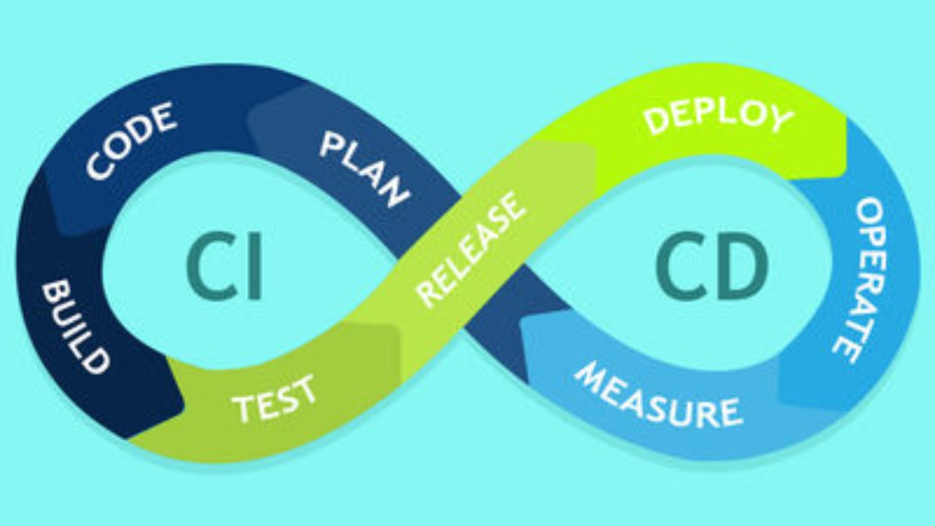


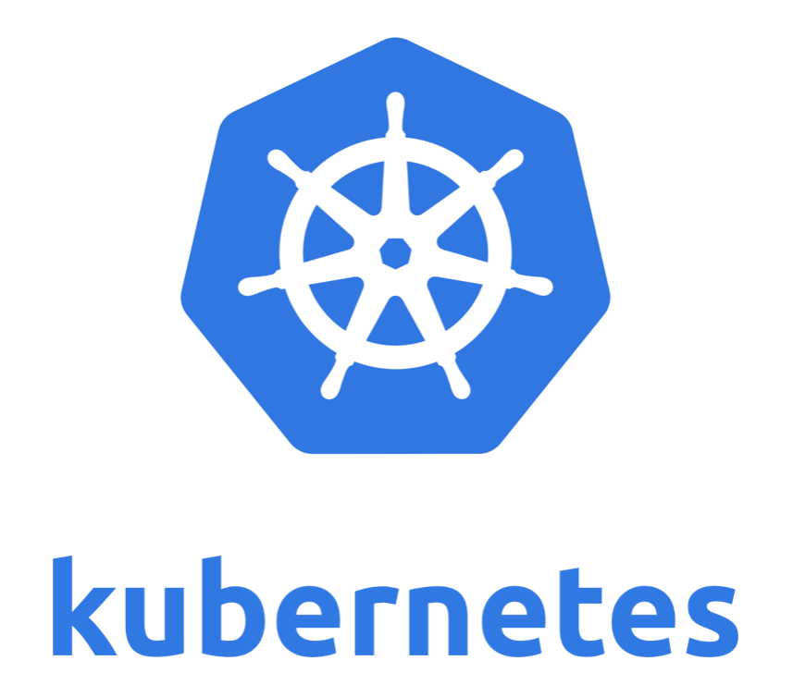
My tech skills

Slide 4

What are my goals?
To help people improve their lives with amazing technology and services.
To provide value to teams with unique ideas and solutions.
To continually improve upon myself at all times

Slide 5
What else do I do?
Athletics: I have competed on a amateur level for over a decade and I have won many medals
English Teaching: I am completing an online TEFL (teaching English as a foreign language) so that I can help young people learn English.
Reading: I am an avid reader of non-fiction books on history and economics

Slide 6
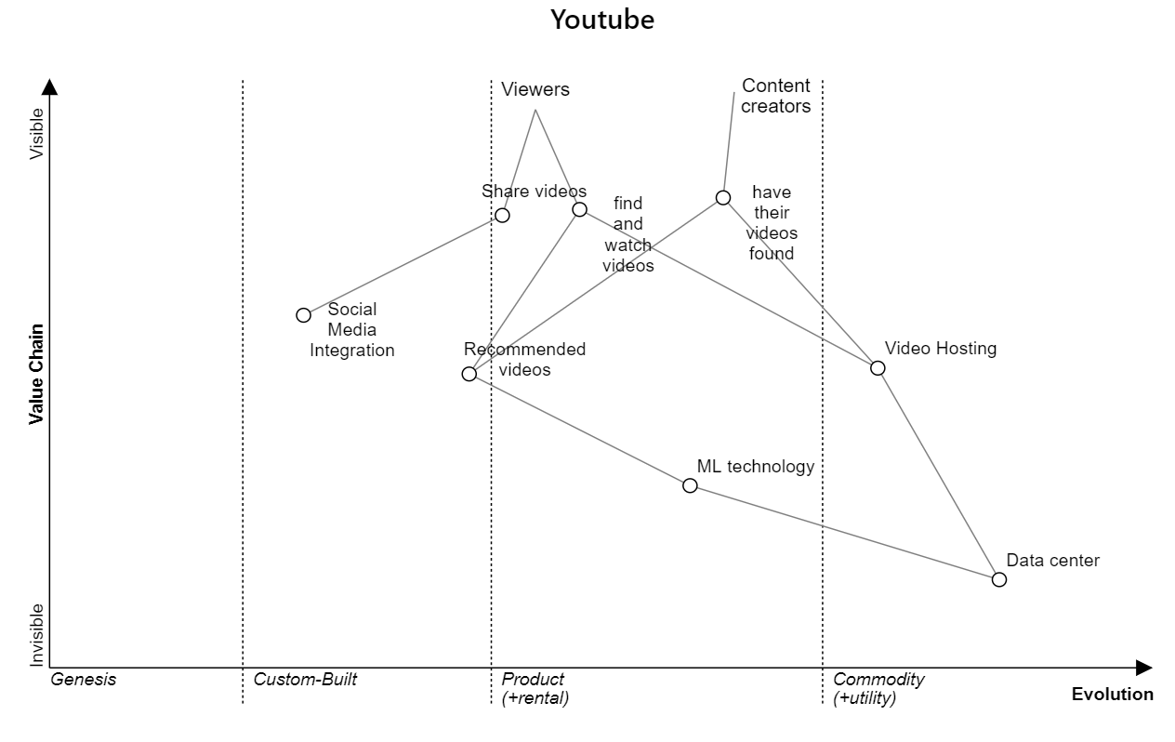
YouTube Wardley map
Based on: https://miro.com/blog/wardley-maps-whiteboard-canvas/

Slide 7






How we use pipelines
Push triggers Jenkins tests
Jenkins merges branches to master
CI
Jenkins triggers Packer to make AMI
CD
Terraform makes instance with AMI
CD
Packer AMI can be used for Terraform
Developer push to Github

Slide 8

Metrics we look for
CPU power
Storage
Fault tolerance
Recovery time
Cost effective

Slide 9

Thank you for listening
https://www.linkedin.com/in/jackfarmer95/
jackfarmer95@gmail.com
https://github.com/jfarmer864

